Slide 1

SQL JOINS
By : L.M.Premitha

Slide 2
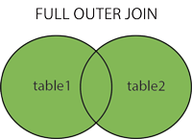
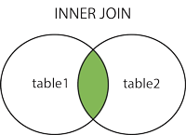
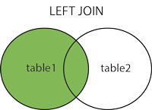
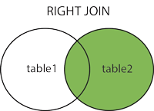
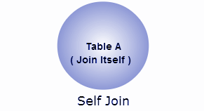
What is Join?
A Join clause is used to combine rows from two or more tables, based on a related column between them.

Slide 3
What are the types of Joins?
Left Join
Right Join
Inner Join
Full Outer Join
Self Join

Slide 4
Left (Outer) Join
Returns all records from the left table, and the matched records from the right table.

Slide 5
Left Join
Customers
SELECT Orders.or_id , Customers.cust-name From Orders LEFT JOIN Customers ON Orders.cust_id = Customers.id
id | cust_name | designation
1 | abc | A
2 | pqr | B
3 | mno | C
or_id | cust_name
601 | abc
602 | null
603 | pqr
Orders
or_id | amount | cust_id
601 | 1000 | 1
602 | 2000 | 4
603 | 1500 | 2

Slide 6
Right (Outer) Join
Returns all records from the right table, and the matched records from the left table.

Slide 7
Right Join
Customers
SELECT Orders.or_id , Customers.cust-name From Orders RIGHT JOIN Customers ON Orders.cust_id = Customers.id
id | cust_name | designation
1 | abc | A
2 | pqr | B
3 | mno | C
or_id | cust_name
601 | abc
603 | pqr
null | mno
Orders
or_id | amount | cust_id
601 | 1000 | 1
602 | 2000 | 4
603 | 1500 | 2

Slide 8
Inner Joins
Returns records that have matching values in both tables.

Slide 9
Inner Join
Customers
SELECT Orders.or_id , Customers.cust-name From Orders INNER JOIN Customers ON Orders.cust_id = Customers.id
id | cust_name | designation
1 | abc | A
2 | pqr | B
3 | mno | C
or_id | cust_name
601 | abc
603 | pqr
Orders
or_id | amount | cust_id
601 | 1000 | 1
602 | 2000 | 4
603 | 1500 | 2

Slide 10
Full (Outer) Join
Returns all records from the left table, and the matched records from the right table.

Slide 11
Full (Outer)Join
Customers
SELECT Orders.or_id , Customers.cust-name From Orders FULL OUTER JOIN Customers ON Orders.cust_id = Customers.id
id | cust_name | designation
1 | abc | A
2 | pqr | B
3 | mno | C
or_id | cust_name
601 | abc
602 | null
603 | pqr
null | mno
Orders
or_id | amount | cust_id
601 | 1000 | 1
602 | 2000 | 4
603 | 1500 | 2

Slide 12
Self Join
A self join is a regular join, but the table is joined with itself.

Slide 13
Self Join
One table considered as two tables.
Join table to itself.
SELECT DISTINCT E.name , From EMPLOYEE INNER JOIN Employee M ON E.emp_id = M.manager_id
Employee
emp_id | name | manager_id | DOJ
121 | abc | A | …..
321 | pqr | B | …..
421 | mno | C | …..

Slide 14


